Slide 1
Sentiment Analysis Using BERT and Multi-Instance Learning
Iryna Burak
Pablo Restrepo
May 11, 2020

Slide 2
Presentation Overview: What did we do on the last 2 weeks?
Getting Embeddings for our data using BERT:
1.1 Analyzing and preparing our data.
1.2. Exploring BERT options and hyperparameters.
1.2. Getting embeddings for our data.
Implementing our first MILNET (Multi Instance Learning Network) using PyTorch
Plan for the next two weeks.
References.
‹#›

Slide 3

1. Getting Embeddings for our data using BERT:
‹#›

Slide 4
1.1 Analyzing and preparing our data
Amazon reviews Dataset:
Categories:
Grocery and Gourmet Food -> 198.502 rows
Health and Personal Care -> 151.254 rows
Beauty -> 346.355 rows
After filtering those containing the word: “organic”:
Grocery and Gourmet Food -> 9.962 rows
Health and Personal Care -> 3.272 rows
Beauty -> 2.227 rows
TOTAL: 15.561 rows
‹#›

Slide 5
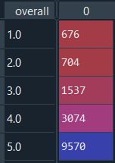
1.1 Analyzing and preparing our data
How to asses the sentiment of a comment?
if rating < 3 -> Negative Sentiment
if rating = 3 -> Neutral Sentiment
if rating > 3 -> Positive Sentiment
Negative sentiment: 1.380 -> 8,86%
Neutral sentiment: 1.537 -> 9,87%
Positive sentiment: 12.644 -> 81,25%
‹#›

Slide 6
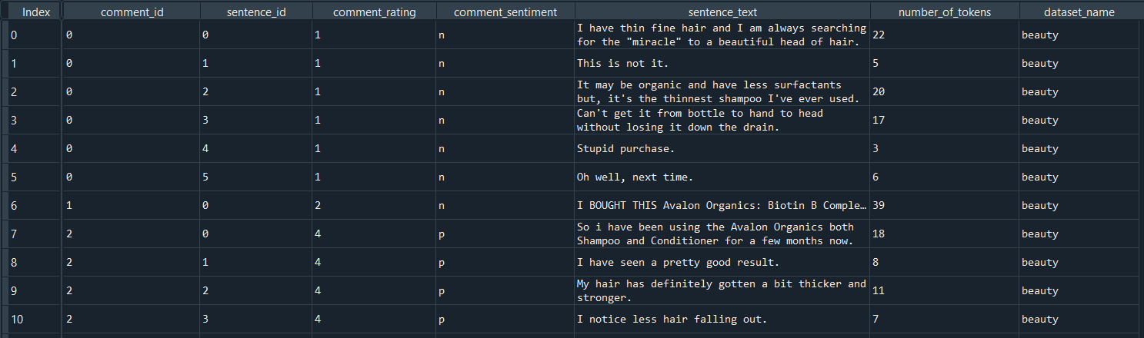
1.1 Analyzing and preparing our data
Processing our data:
Splitting the comments into sentences using NLTK:
Total number of sentences: 129.867
‹#›

Slide 7
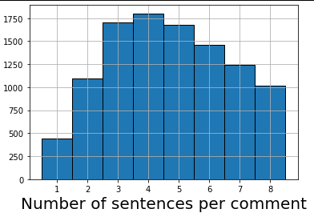
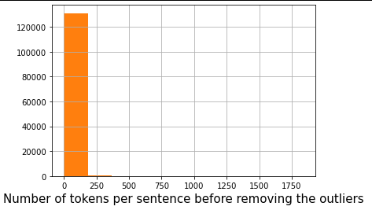
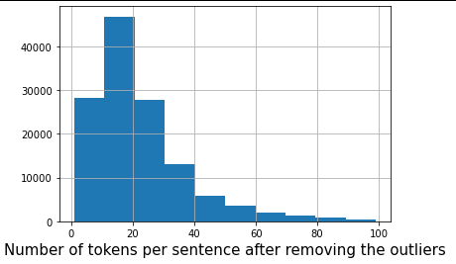
1.1 Analyzing and preparing our data
Tokens per sentence:
BERT can only handle sentences with a maximum of 512 tokens!
We have sentences with more than 1000 tokens
0.2% of the dataset has more than 100 tokens.
‹#›

Slide 8
1.2. Exploring BERT options and hyperparameters.
What Tool to use?
What Bert model to use?
Pooling layer and pooling strategy?
‹#›

Slide 9
1.2. Exploring BERT options and hyperparameters.
What Tool to use?
Using BERT library.
BERT as a Service.
Other Tools for getting BERT embeddings: SBERT (rich embeddings for BERT).
We decided to use “BERT as a Service”.
‹#›

Slide 10
1.2. Exploring BERT options and hyperparameters.
What Bert model to use?
Many pretrained models available
Huggingface Transformers library has 24 different BERT pretrained models.
We decided to use “bert-base-uncased”.
‹#›

Slide 11
1.2. Exploring BERT options and hyperparameters.
Pooling Layer and Pooling Strategy?
For each token of we have 12 separate vectors.
Different layers of BERT encode very different kinds of information
To get individual vectors, we need to combine some of the layer vectors, which layer or combination of layers provides the best representation?
This is application dependent!.
We decided to use BERT as a Service default parameters: pooling strategy: Reduce Mean Pooling layer = -2.
‹#›

Slide 12
1.3. Getting embeddings for our data.
Final Configuration:
Tool: Bert as a Service
Model: “bert-base-uncased”
Pooling Strategy: Reduce Mean
Pooling Layer = -2
767 values per sentence
file size: 2.1 gb
‹#›

Slide 13
2. Implementing MilNet
The authors of the article implemented MilNet in Lua using torch.
We decided to use PyTorch.
Lua implementation is still a good reference.
‹#›

Slide 14
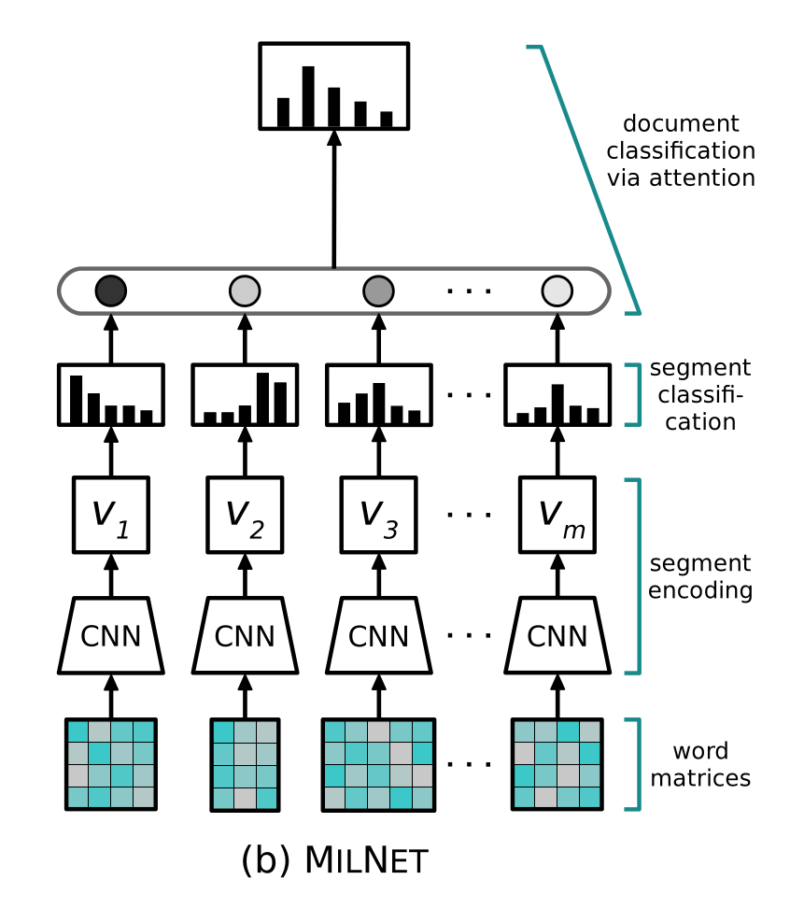
2. Implementing MilNet
BERT
Angelidis S. & Lapata M, Multiple Instance Learning Networks for Fine-Grained Sentiment Analysis, University of Edinburgh
‹#›

Slide 15
2. Implementing MilNet
Our implementation doesn’t crash.
It overfits on a small dataset.
‹#›

Slide 16
3. Plan for the next two weeks
Implement and run our baselines.
Train the model on the whole dataset.
More data analysis!
‹#›

Slide 17
4. References
Reimers N. & Gurevych I (2019). Sentence-BERT: Sentence Embeddings using Siamese BERT-Networks, https://arxiv.org/abs/1908.10084
Pretrained models,Tansformers 2.0.9 documentation, https://huggingface.co/transformers/pretrained_models.html
McCormick C. (2019), BERT word Embeddings Tutorial, https://mccormickml.com/2019/05/14/BERT-word-embeddings-tutorial/
Xiao, H. BERT as a Service, https://github.com/hanxiao/bert-as-service
‹#›

